Slide 1



Introduction to Software Business Product management
Emily Crose
For
Oakland university

Slide 2
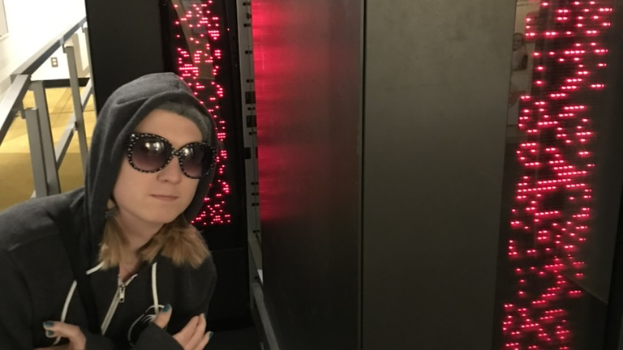
Who am I?
Emily Crose
Information security professional 13 years
Frequent public speaker
Formerly US Intelligence Community
Current research manager @ Sophos

Slide 3

What about you?
Notes:
What about you all? Where do you come from? What kinds of backgrounds do you have?

Slide 4

Course overview
Basic operations of this course
What will we be talking about in this course?
What do you want to learn?

Slide 5
Basic Course Operation
Meet three times/week for 5 weeks
Tuesdays, Wednesdays & Thursdays
7AM Eastern – 10AM Eastern
Moodle
Github
Notes:
We will be meeting 3 times a week on Tuesdays, Wednesdays and Thursdays for the next 5 weeks. We’ll begin around 7AM and end around 10AM Eastern time.
I will make class materials available in two places: Moodle, and Github. Github is one of the tools that we’ll be talking about in this class, so if you want to challenge yourself to put some of what we talk to into practice, jump over to github where the class materials will also be made available.

Slide 6
Material overview
Understanding modern technology fundamentals
How it works
How it is maintained
The Software Development Life Cycle (SDLC)
Tools for managing software development
Management techniques for maintaining codebases
Standards that apply to these topics
Notes:
In this class, we’re going to talk about modern technology. How it works, and how we maintain it. We’ll talk about some of the most popular tools you’ll use in this work. You will also have opportunities to be exposed to these tools in this class through presentations, but also though hands-on use for some of these tools if you choose to do so.
We’re going to talk about the Software Development Life Cycle (Also called the SDLC) and how this general principal applies to developing and maintaining codebases. Alongside that topic, we will talk about some management techniques which can be used to help apply the principals from the SDLC to your everyday work.
Finally, we will talk about some of the standards which apply to these topics, and a few that will apply directly to your work.

Slide 7
Hardware vs software

Slide 8
hardware fundamentals

